Slide 1
Predicting Coronavirus Statistics
L. Van Warren
University of Arkansas
April 25, 2020

Slide 2
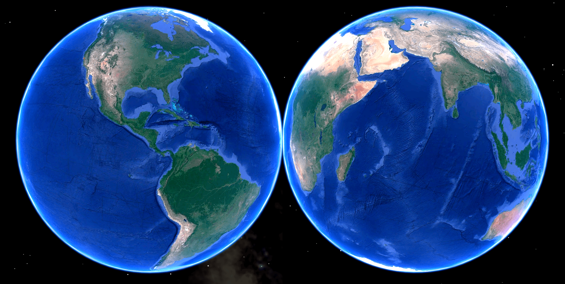
Three Goals for Understanding Coronavirus
For World, National, State and County Scopes Predict Infection:
Doubling Time
Duration
Recurrence
Infer
Testing Rate
Mortality Rate
© 2020 L. Van Warren • All Rights Reserved

Slide 3
Doubling Time: World
© 2020 L. Van Warren • All Rights Reserved

Slide 4
Doubling Time vs. Time: World
© 2020 L. Van Warren • All Rights Reserved

Slide 5
Doubling Time: US, Italy, South Korea
© 2020 L. Van Warren • All Rights Reserved

Slide 6
Doubling Time vs. Time: US, Italy, South Korea
© 2020 L. Van Warren • All Rights Reserved

Slide 7
Doubling Time: NY, CA, AR
© 2020 L. Van Warren • All Rights Reserved

Slide 8
Doubling Time vs. Time: NY, CA, AR
© 2020 L. Van Warren • All Rights Reserved

Slide 9
Doubling Time: NYC, SFO, Pulaski
© 2020 L. Van Warren • All Rights Reserved

Slide 10
Doubling Time vs. Time: NYC, SFO, Pulaski
© 2020 L. Van Warren • All Rights Reserved

Slide 11
Doubling Time: Method
© 2020 L. Van Warren • All Rights Reserved

Slide 12

Duration: World
© 2020 L. Van Warren • All Rights Reserved

Slide 13
Duration: US, Italy, South Korea
© 2020 L. Van Warren • All Rights Reserved

Slide 14
Duration: NY, CA, AR
© 2020 L. Van Warren • All Rights Reserved

Slide 15
Duration: NYC, SFO, Pulaski
© 2020 L. Van Warren • All Rights Reserved

Slide 16
Duration: Method
© 2020 L. Van Warren • All Rights Reserved

Slide 17
Recurrence: World
© 2020 L. Van Warren • All Rights Reserved

Slide 18
Recurrence : US, Italy, South Korea
© 2020 L. Van Warren • All Rights Reserved

Slide 19
Recurrence : NY, CA, AR
© 2020 L. Van Warren • All Rights Reserved

Slide 20
Recurrence : NYC, SFO, Pulaski
© 2020 L. Van Warren • All Rights Reserved

Slide 21
Recurrence : Method
© 2020 L. Van Warren • All Rights Reserved

Slide 22
Finer Distinctions
Nursing Homes
Prisons
Meat-Packing Plants
Hospitals
Cruise-Ships
Aircraft
Travelers
What do they have in common?

Slide 23
Credits and Acknowledgements
Google Earth

