Slide 1
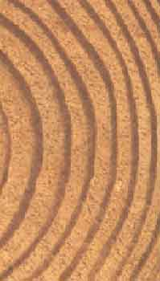
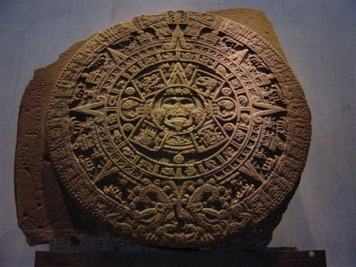
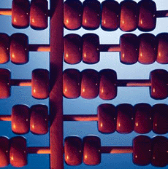
Base One
L. Van Warren

Slide 2
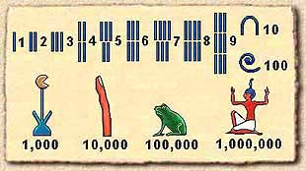
Start at the beginning…

Slide 3
What is a placeholder?

Slide 4
1
2
2
8

Slide 5
• 100 + • 10 + • 1
1
2
8

Slide 6
• 10² + • 10¹ + • 10⁰
1
2
8

Slide 7
• 100 + • 10 + • 1
1
2
8

Slide 8
+ • 10 + • 1
100
2
8

Slide 9
+ + • 1
100
20
8

Slide 10
+ +
100
20
8

Slide 11
100
20
8

Slide 12
1
2
8

Slide 13
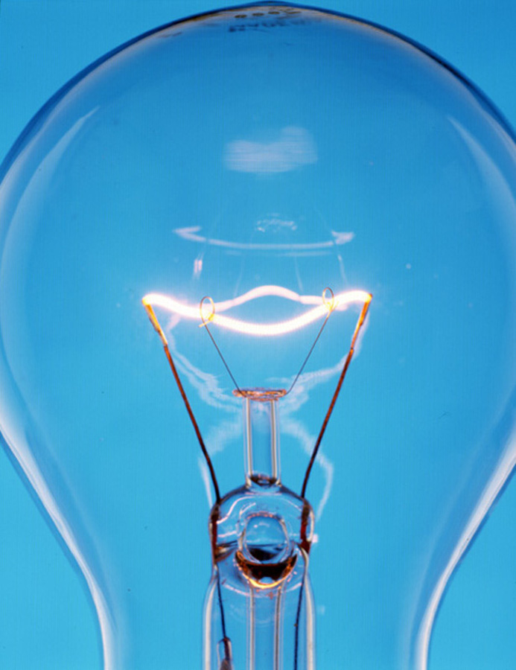
Consider Placeholders As Dimensions…

Slide 14
How many placeholders?
1
2
2
8
Three

Slide 15
128
Three

Slide 16
128

Slide 17
128

Slide 18
128

Slide 19
128
tens
ones
hundreds

Slide 20
128
tens
ones
hundreds

Slide 21
How many dimensions in a cube?

Slide 22
How many dimensions in a square?

Slide 23
How many dimensions in a line segment?

Slide 24
How many dimensions in a point?

Slide 25
How many dimensions in a point?
0

Slide 26
How many symbols in base one?

Slide 27
How many symbols in base one?

Slide 28
How do we count in base one?

Slide 29
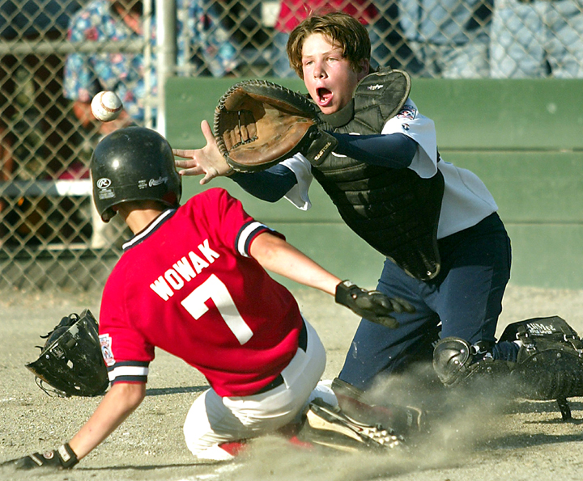
Base 1 – Counting
|
||
||||
||||

Slide 30
How do we add in base one?

Slide 31
+ = ?

Slide 32
+ = ?

Slide 33
+ = ?

Slide 34
+ =

Slide 35
+ =

Slide 36
Addition is equivalent to Grouping

Slide 37
Grouping is a powerful idea.

Slide 38
Addition is “closed” in base one.

Slide 39
Meaning we can represent any sum in the same counting system. (given sufficient time)

Slide 40
How do we subtract In base one?

Slide 41
- = ?

Slide 42
- = ?

Slide 43
- = ?

Slide 44
- = ?

Slide 45
- = ?

Slide 46
- = ?

Slide 47
- = ?

Slide 48
- = ?

Slide 49
- = ?

Slide 50
- = ?

Slide 51
- = ?

Slide 52
- =

Slide 53
Subtraction is equivalent to Separating

Slide 54
Subtraction is not “closed” in base one.

Slide 55
The antistick requires another bit that makes base two!

Slide 56
- =

Slide 57
The antistick is a negative stick with the annihilation property:

Slide 58
+ =

Slide 59
How do we multiply In base one?

Slide 60
x =

Slide 61
The second number tells us the number of copies of the first.

Slide 62
x =

Slide 63
And visa versa

Slide 64
x =

Slide 65
This demonstrates that multiplication in base one is commutative.

Slide 66
Multiplication is repeated addition.

Slide 67
Multiplication in base one is “closed”.

Slide 68
Base One Squares

Slide 69
Squaring is a special case of multiplication.

Slide 70
x =

Slide 71
Choosing a different symbol reminds us of the meaning of “squaring”.

Slide 72
x =

Slide 73
Or:

Slide 74
x =

Slide 75
x =

Slide 76
How do we find the square root in base one?

Slide 77
“Find the number that when multiplied by itself gives the original number.”

Slide 78
If the number is a perfect square, the square root is the length of one side.

Slide 79
 = ?

Slide 80
 = ?

Slide 81
 = ?

Slide 82
 = ?

Slide 83
 = ?

Slide 84
 =

Slide 85
 =

Slide 86
How do we divide In base one?

Slide 87
Division is repeated subtraction.

Slide 88
= ?

Slide 89
= ?

Slide 90
= ?

Slide 91
= ?

Slide 92
= ?

Slide 93
= ?

Slide 94
= ?

Slide 95
= ?

Slide 96
= ?

Slide 97
= ?

Slide 98
= ?

Slide 99
= ?

Slide 100
= ?

Slide 101
=

Slide 102
Division, like subtraction is not closed in base one.

Slide 103
= ?

Slide 104
=

Slide 105
Base One Trigonometry

Slide 106
We must introduce some new symbols.

Slide 107
These symbols are not used for counting.

Slide 108
These symbols are containers for copies of our counting symbol.

Slide 109
x

Slide 110
x

Slide 111
x

Slide 112
x

Slide 113
x

Slide 114
x

Slide 115
x

Slide 116
x

Slide 117
x

Slide 118
x

Slide 119
x

Slide 120
x

Slide 121
x

Slide 122
x

Slide 123
y
x

Slide 124
y
x

Slide 125
y
x

Slide 126
y
x

Slide 127
y
x

Slide 128
y
x

Slide 129
y
x

Slide 130
y
x

Slide 131
y
x

Slide 132
r
y
x

Slide 133
r
y
x

Slide 134
Name relationships.

Slide 135
r
y
θ
x

Slide 136
y
r
sin(θ) =
r
y
θ
x

Slide 137
y
r
sin(θ) =
r
y
θ
sin(θ) =
x

Slide 138
r
x
cos(θ) =
r
y
θ
x

Slide 139
r
x
cos(θ) =
r
y
θ
cos(θ) =
x

Slide 140
y
r
tan(θ) =
x
y
θ
x

Slide 141
y
r
tan(θ) =
x
y
θ
tan(θ) =
x

Slide 142
Base One Probability

Slide 143
Ask some friends to show you a number by holding up their hands.

Slide 144
Then plot the result in base one.

Slide 145
Number of appearances
Number shown:

Slide 146
Questions?

